Slide 1
Brief Introduction to Generative Adversarial Networks(GAN)
Wang Shaoshen @UTS
Notes:
Deep generative models learned through adversarial training have become increasingly popular for their ability to generate naturalistic image textures. However, some shape geometry information is not taken into account by existing generative models. I would like to give a brief introduction to some different kinds of GANs(DCGAN, contidional GAN, infoGAN) as well as how to incorporating information about object into the generation process.

Slide 2
Brief Introduction to GANs
GAN
Deep Convolutional GAN
Conditional GAN
Info GAN
Some experiment results

Slide 3
Why study generative models?
Excellent test of our ability to use high-dimensional, complicated probability distributions
Simulate possible futures for planning or simulated RL
Missing data
Multi-model outputs
Realistic generation tasks
Notes:
Rather than match between one input and output, GAN generates many outputs.
GAN is more realistic

Slide 4
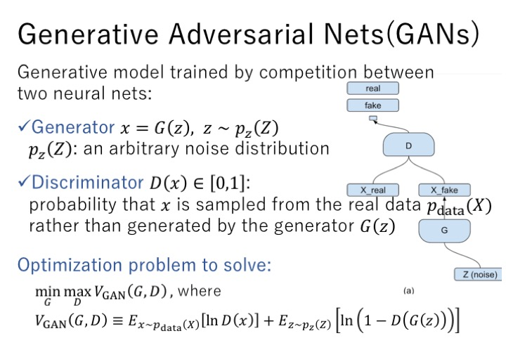
Notes:
Different kinds of GANs have been studied and discussed.
The basic idea of GAN is to take a collection of training examples and form some representation of probability distribution
G will learn the distribution of training data
The role of D is to look at a sample and tell whether the sample is real or fake
G,D are differentiate functions that can be learnt by Gradient Decent
We usually represents it as deep neural network but it can be other functions

Slide 5
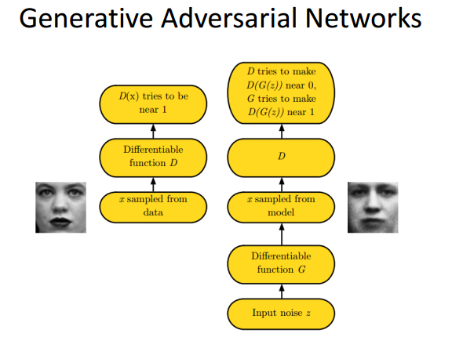
Notes:
GANs approach the training of deep generative models from a game theory perspective using a minimax game.

Slide 6
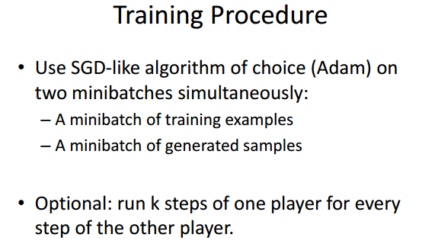

Slide 7
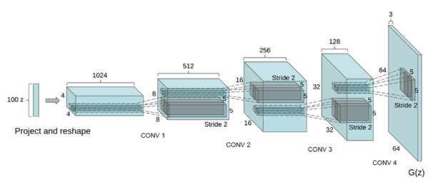
Deep Convolutional GAN(DCGAN)
All convolutional nets
No global average pooling
Batch normalization (stable)
ReLU
Notes:
Original Multi-layer
One contribution of DCGAN is using batch normalization, making learning process stable

Slide 8
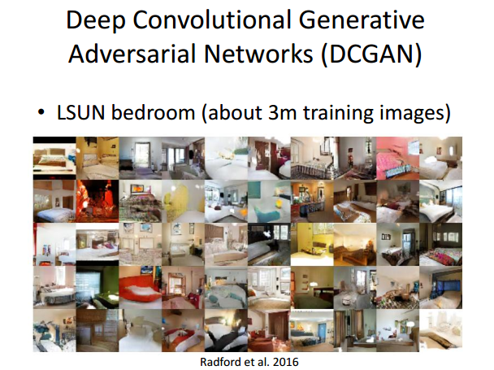
Notes:
Variety of images

Slide 9
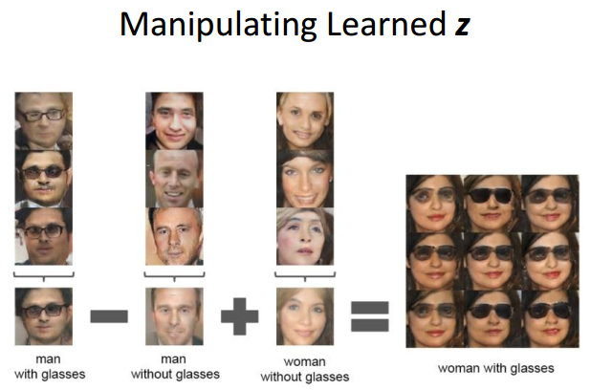
Notes:
This is just like word2vec

Slide 10
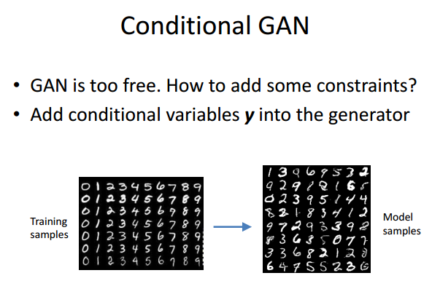

Slide 11
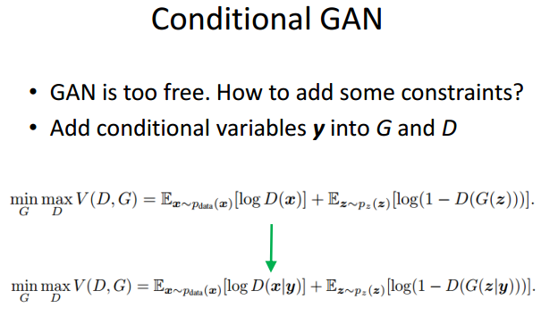

Slide 12
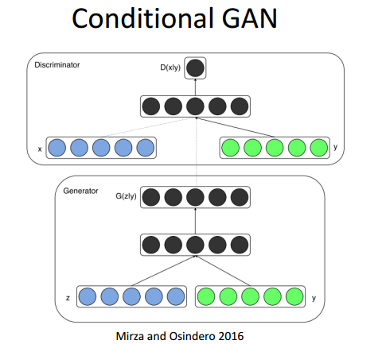

Slide 13
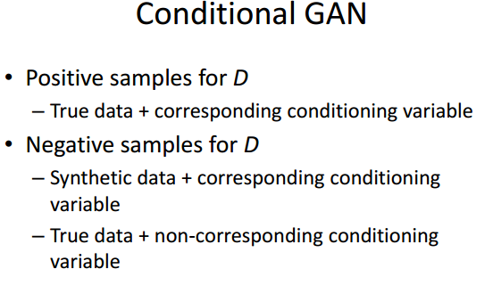

Slide 14
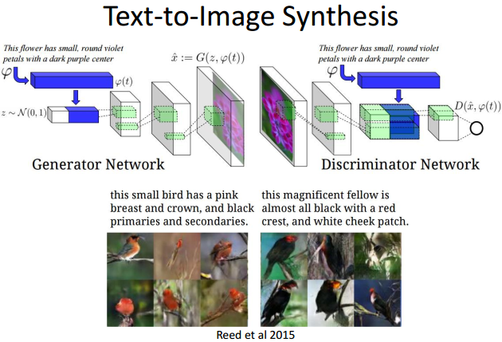

Slide 15
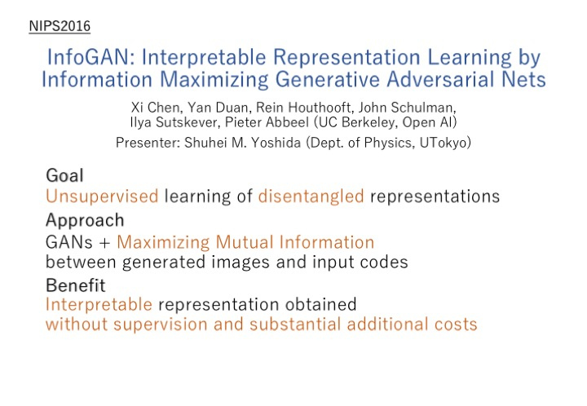
Notes:
How to deal with entangled representation

Slide 16
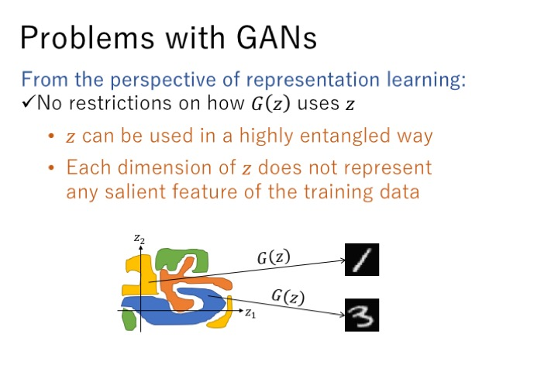
Notes:
Salient 显著的

Slide 17
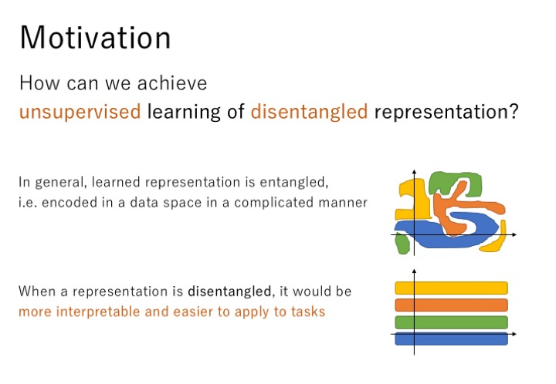

Slide 18
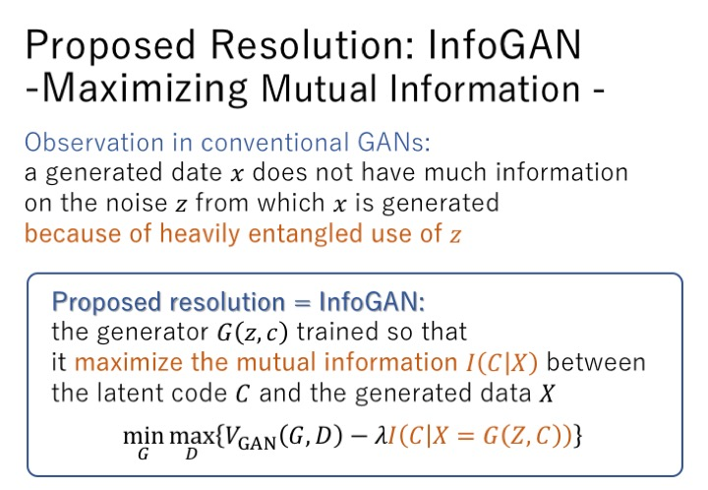
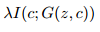
Notes:
Maximize mutual information

Slide 19
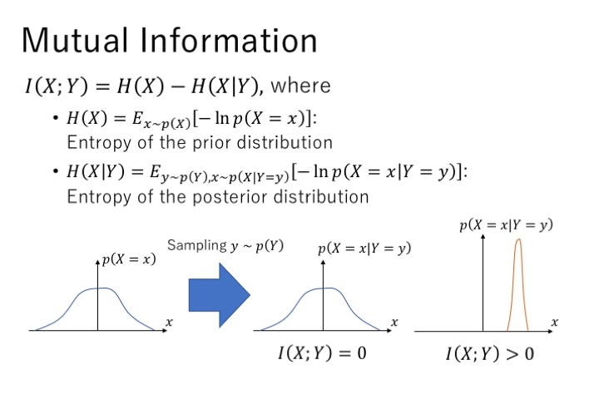
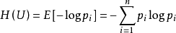
Notes:
H(p) = Sigma p log(p)
X given Y
Subtract the uncertain of X given Y

Slide 20
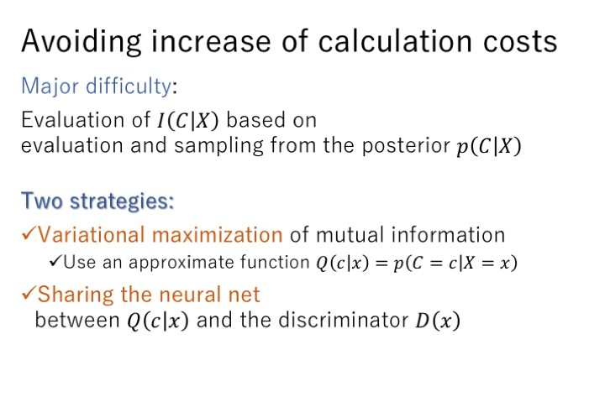

Slide 21
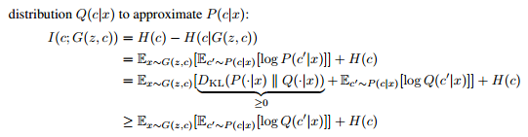
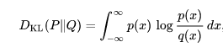
Variational Maximization
The posterior is hard to access

Slide 22
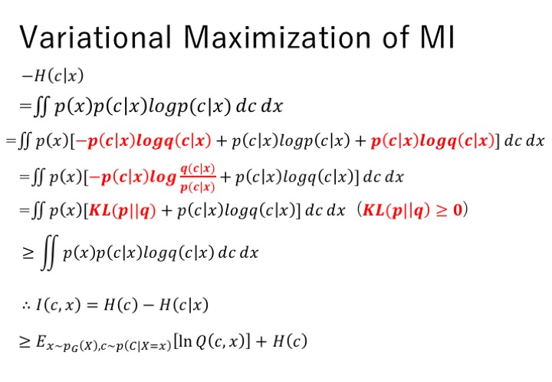
Notes:
Use a function to estimate Mutual Information

Slide 23
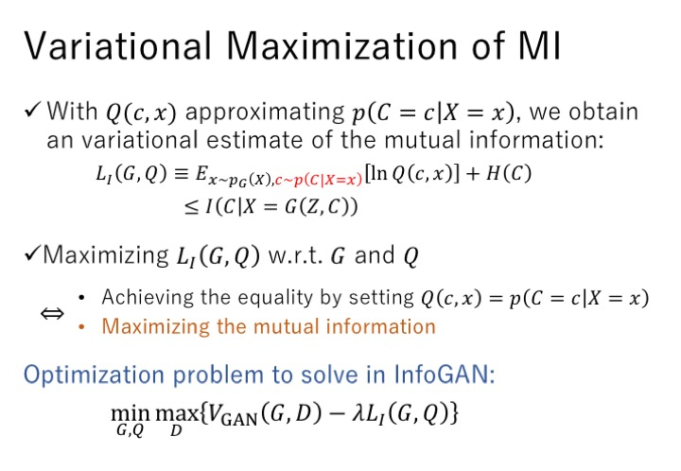

Slide 24
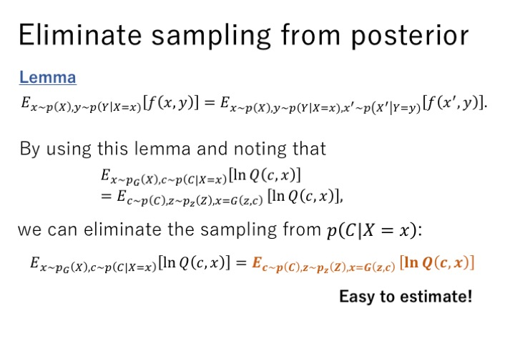

Slide 25
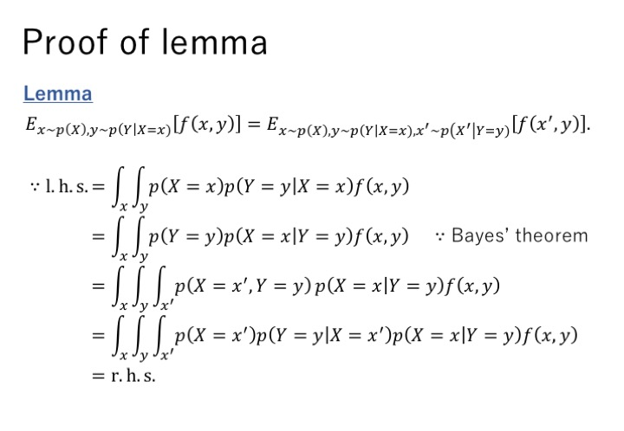
Notes:
X’=X prime

Slide 26
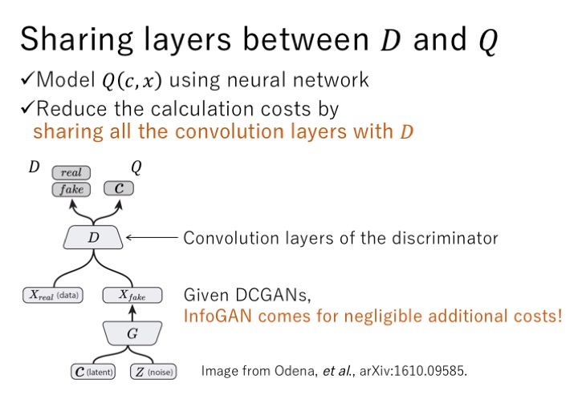

Slide 27
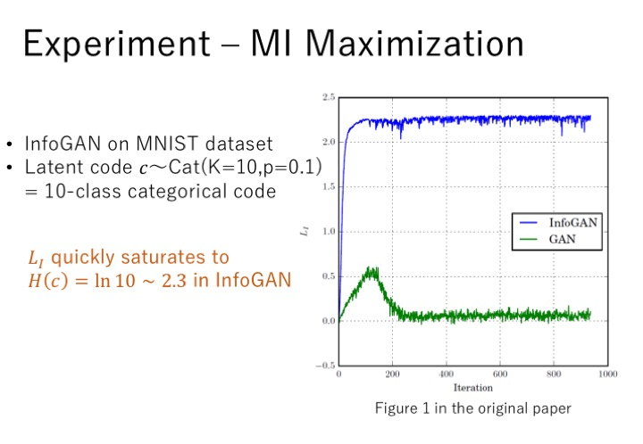

Slide 28
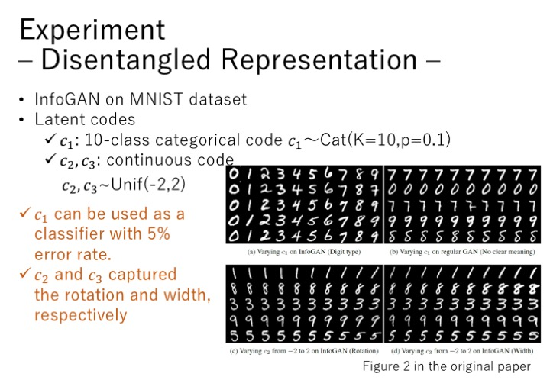

Slide 29
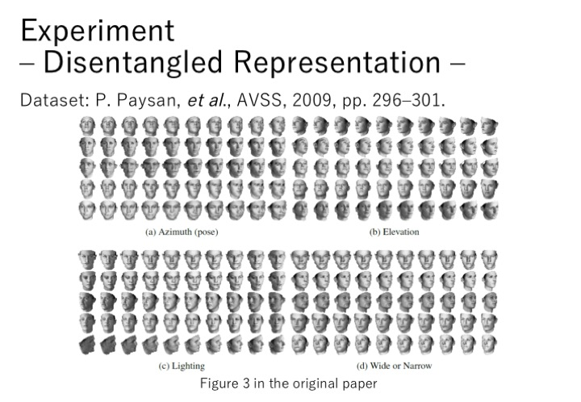

Slide 30
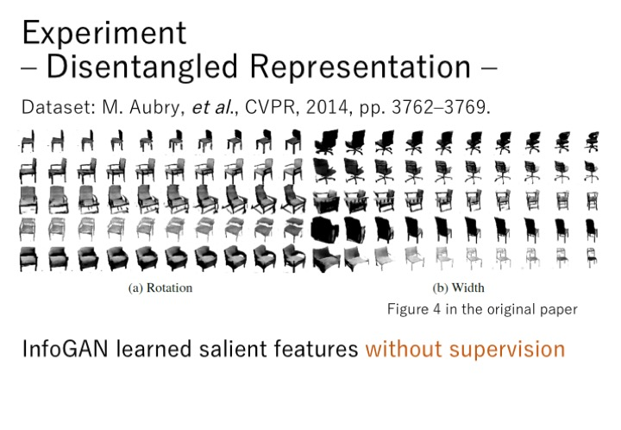

Slide 31
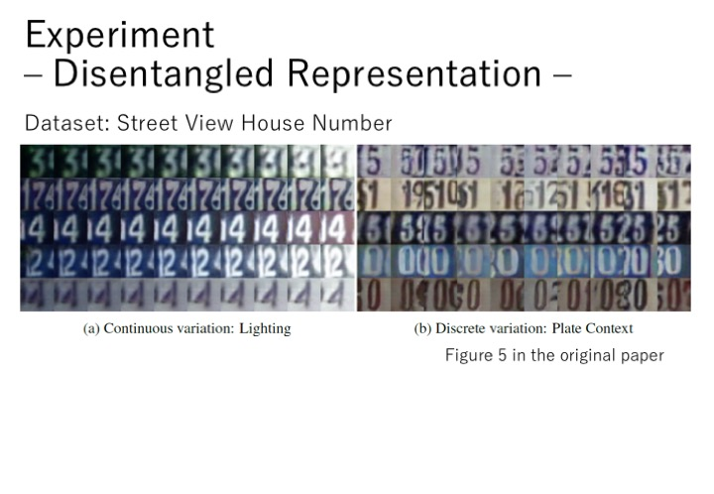

Slide 32
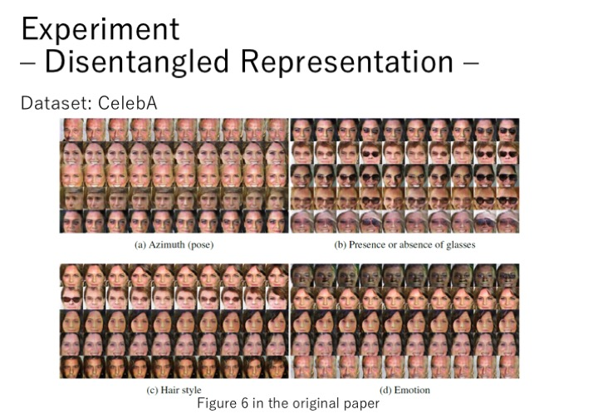

Slide 33
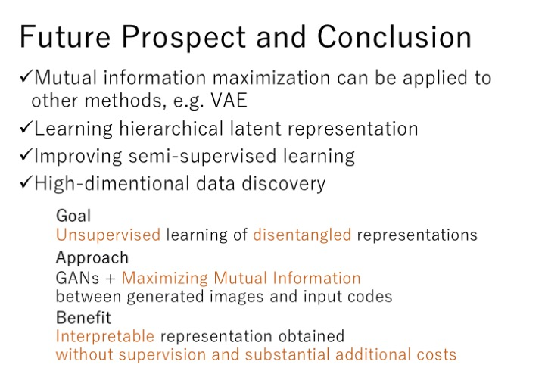

Slide 34
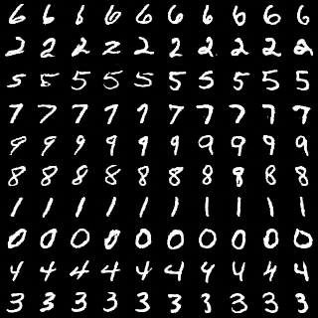
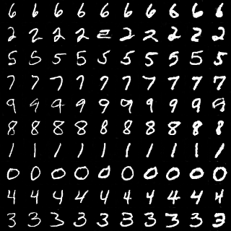
Experiment result
Purpose: Add extra structure or position information to latent variables in order to manipulate generated image
Code Used: https://github.com/kevinwss/InfoGAN_tutorial

Slide 35
Reference
http://dl.ee.cuhk.edu.hk/slides/gan.pdf
http://www.iangoodfellow.com/slides/2016-12-04-NIPS.pdf
https://gist.github.com/awjuliani/c9ecd8b37d33d6855cd4ed9aa16ce89f#file-infogan-tutorial-ipynb
YouTube: NIPS 2016 - Generative Adversarial Networks - Ian Goodfellow

